Slide 1
Introduction to F#
Basics of Functional Programming

Slide 2
Remark
For beginners only.

Slide 3
About the Speaker
Chang Hai Bin
B.Sc. (Math), NUS
M.Sc. (Math), Uni of Michigan
Financial Engineer, Numerical Technologies

Slide 4
What is Functional Programming (FP)?
Based on combinatory logic
Uses functions to solve problem
Other Good Properties (depend on language)
  Purity/Type-check/Recursive/Lazy-evaluation/homoiconicity

Slide 5
FP Languages
Ancestor:
  ML (1973)
  Haskell (1990)
Cousins:
  OCaml(1996)
  Scala (2004)
  F# (2005)
  Elm (2012)
  ReasonML (2018)
Remark: Some also considers LISP (1958) and their dialects (e.g. Clojure 2007) functional languages.

Slide 6





Who uses FP?
Haskell
Clojure / F#
OCaml
Scala

Slide 7
Why Learn FP?
Concise code
Ability to reason
Unlock problems
Better Salary

Slide 8
This Talk: F#
There are also Scala, Haskell, Clojure, Elm Meetups in Singapore.

Slide 9
Should I switch from C# to F#?
Eager Learner: Yes!
  Fun! Easy to Learn!
  Access other FP languages!
  Change the way you think.
  Use functional-technique in C# code.
Skeptics: Yes.
  A lot of new features in C# comes from F#.
  F# has better syntax to learn these concepts.

Slide 10
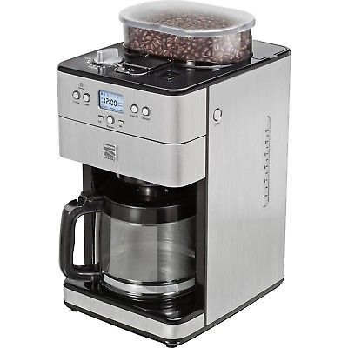
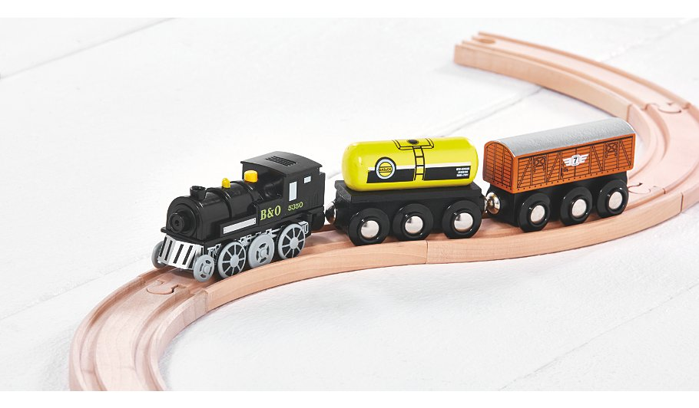
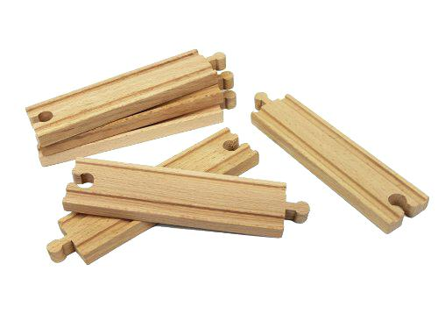
Core Concept
Functions are things
Compose functions

Slide 11
What is a function?
Function is a machine that take an input, and returns an output

Slide 12
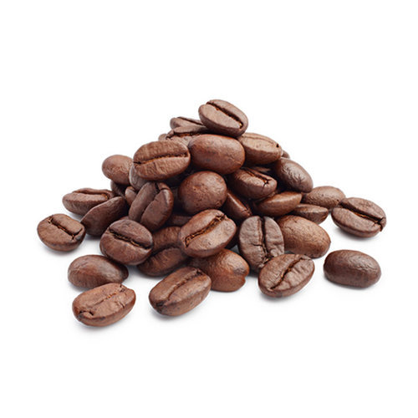
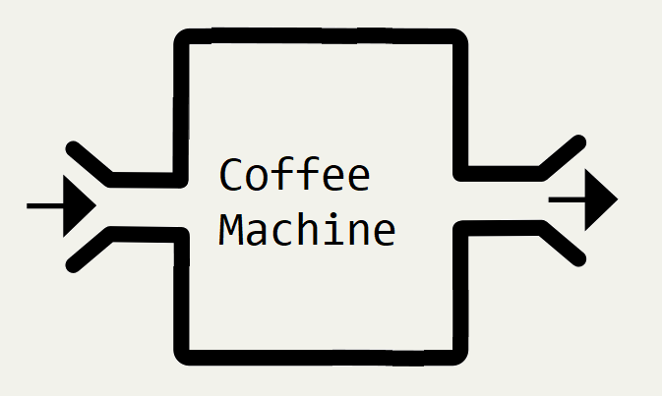


Slide 13


Slide 14


Slide 15


Slide 16
F# Example
let f x = x + 5
f 30 // 35
f 100 // 105

Slide 17
Notation
(To Define)
In Math:
let f(x) = x + 5
In F#:
let f x = x + 5
No Brackets (())

Slide 18
Notation
(To Use)
In Math:
let y = f(100)
In F#:
let y = f 100
No Brackets (())

Slide 19
Example

Slide 20
let f x = “Hello ” + x
f “John” // “Hello John”
f “Jane” // “Hello Jane”

Slide 21
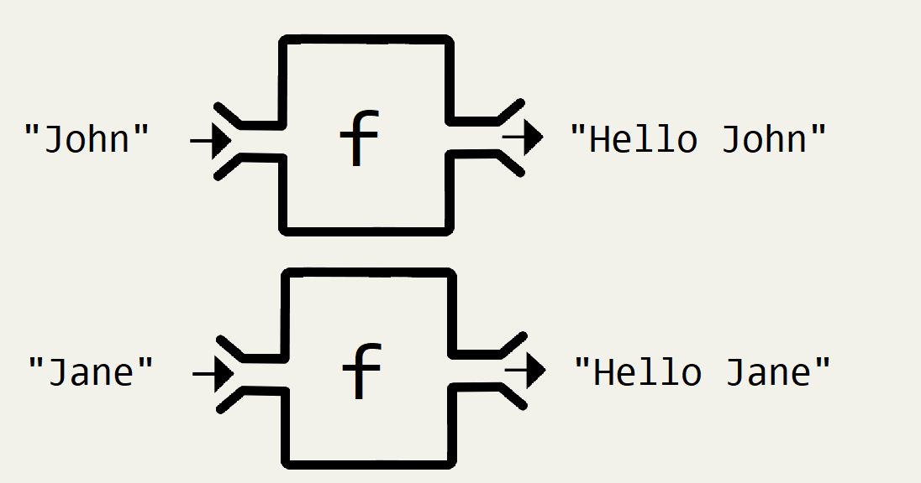

Slide 22
Example

Slide 23
let f x = String.length x
f “Hello” // 5
f “Computer” // 8
f : string -> int

Slide 24
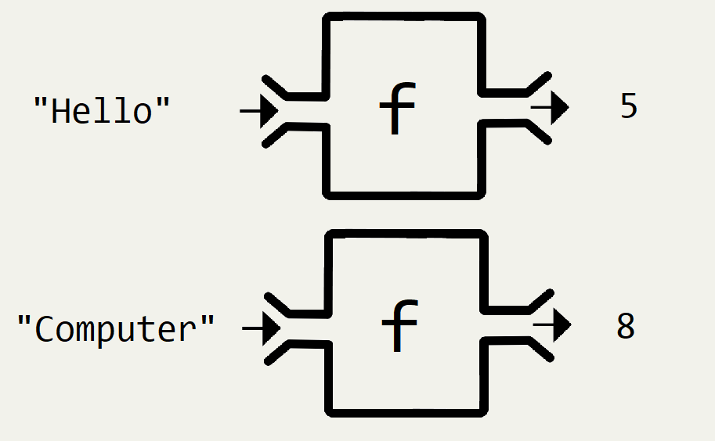

Slide 25
Example

Slide 26
let f xs = List.sum xs
f [1..10] // 55
f [2;3;5;7;11] // 28
f : List<int> -> int

Slide 27
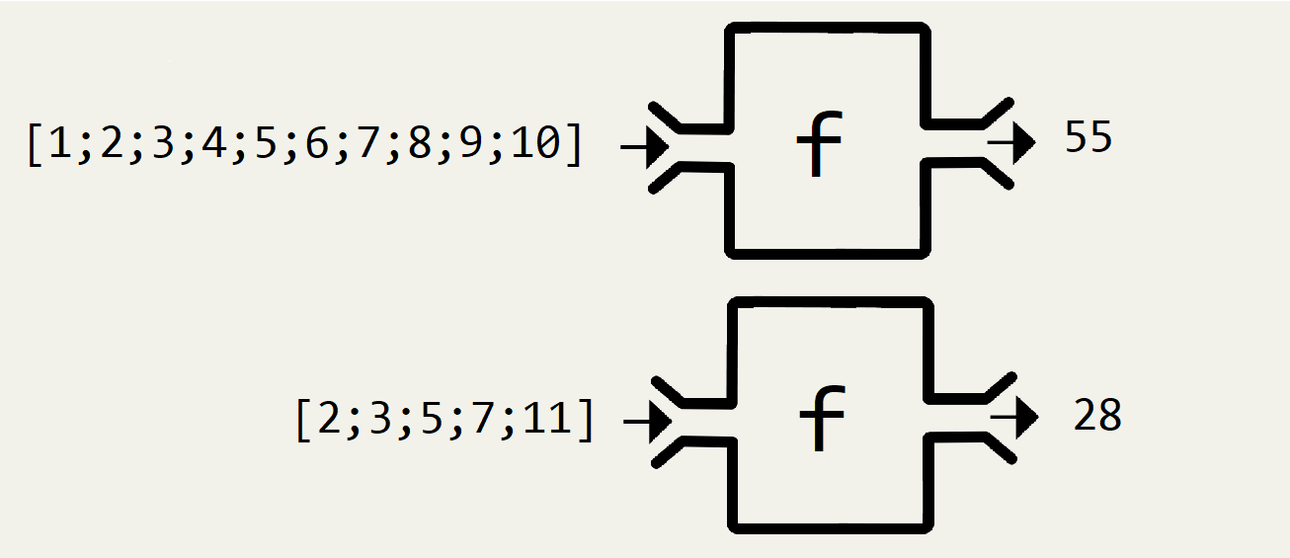

Slide 28
Multiple inputs
let f x y = x + y
f 2 3 // 5
f 30 70 // 100
f : int -> int -> int

Slide 29
Notation
(To Define)
In Math:
let f(x,y) = x + y
In F#:
let f x y = x + y
No Brackets (())
No Commas ,

Slide 30
Notation
(To Use)
In Math:
let z = f(2,3)
In F#:
let z = f 2 3
No Brackets (())
No Commas ,

Slide 31
Multiple inputs
let f x y z = x + y + z
f 2 3 7 // 12
f 30 70 200 // 300
f : int -> int -> int -> int

Slide 32
Multiple inputs
let f a b c d = ......
f : A -> B -> C -> D -> output

Slide 33
Function Composition
Functions can be “connected” if the first output is the input of the second function.

Slide 34


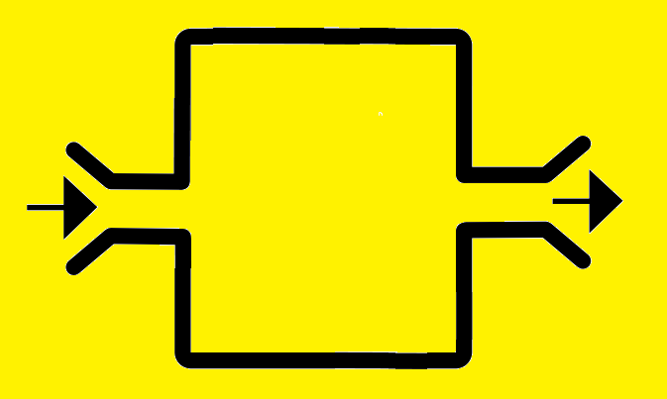

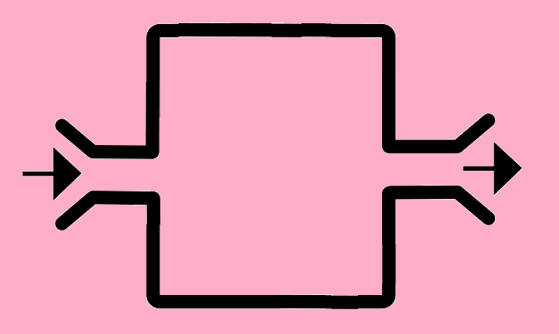

Slide 36

A bigger machine/function!
Banana is “hidden”

Slide 37
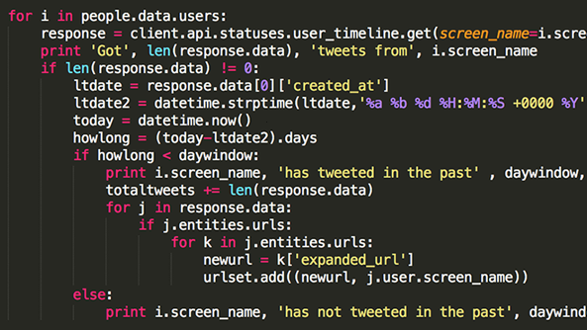

Coffee Machine
Programmer

Slide 38
Coffee Machine
Programmer

Slide 40
f : A -> B
g : B -> C
g (f a)
// = g ( b )
// = c

Slide 41
Example

Slide 42
let f xs = List.sum xs
let g x =
if x > 80 then “A”
else if x > 60 then “B”
else “C”
f : List<int> -> int
g : int -> string

Slide 43
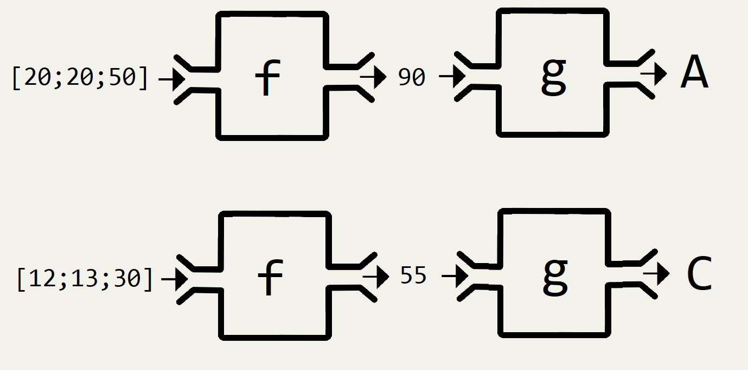

Slide 44
let f xs = List.sum xs
let g x =
if x > 80 then “A”
else if x > 60 then “B”
else “C”
g (f [20; 20; 50]) // g (90)
// “A”

Slide 45
Types must match
f : A -> B
g : C -> D
g (f a) ERROR!
Output of f not accepted by g

Slide 46
|>
Key idea in F#
Pipe-forward operator

Slide 47
What does pipe-forward do?
Change the order of the function and input

Slide 48
let f x = x + 5
f 100 // 105
100 |> f // 105

Slide 49
f : A -> B
g : B -> C
g (f a)
a |> f |> g

Slide 50
f : A -> B
g : B -> C
g (f a)
a
|> f
|> g

Slide 51
f : A -> B
g : B -> C
g (f a)
a
(then do) f
(then do) g

Slide 52
x
|> f
|> g
Start with input x,
Apply input to f,
Apply previous result to g.

Slide 53
x
|> f
|> g
|> h
Start with input x,
Apply input to f,
Apply previous result to g,
Apply previous result to h.

Slide 54
x
|> f
|> g
|> h
|> k
Start with input x,
Apply input to f,
Apply previous result to g,
Apply previous result to h,
Apply previous result to k.

Slide 55
x
|> f
|> g
|> h
|> k
Start with input x,
Apply input to f,
Apply previous result to g,
Apply previous result to h,
Apply previous result to k.
1st output = 2nd input
2nd output = 3rd input
etc.

Slide 56
x
|> f
|> g
|> h
|> k
In C#:
x.Pipe(f).Pipe(g).Pipe(h).Pipe(k);
You can do it in C#, but not as natural.

Slide 57
Benefit
Express Logic Step-by-Step
Easier to read

Slide 58
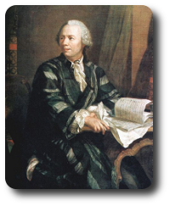

Example
Questions from Project Euler
https://projecteuler.net/

Slide 59
(Question 1) Find the sum of all the multiples of 3 or 5 below from 1 to 999.

Slide 60
(Question 1) Find the sum of all the multiples of 3 or 5 below from 1 to 999.
[1 .. 999]
|> List.filter (fun x -> x % 3 = 0 || x % 5 = 0)
|> List.sum

Slide 61
(Question 1) Find the sum of all the multiples of 3 or 5 below from 1 to 999.
[1 .. 999]
|> List.filter (fun x -> x % 3 = 0 || x % 5 = 0)
|> List.sum
Start with a list from 1 to 999
(then do) filter to keep the numbers you want
(then do) sum those remaining numbers.

Slide 62
(Question 1) Find the sum of all the multiples of 3 or 5 below from 1 to 999.
[1 .. 999]
|> List.filter (fun x -> x % 3 = 0 || x % 5 = 0)
|> List.sum
C# LINQ
Enumerable.Range(1, 999)
.Where(x => x % 3 == 0 || x % 5 == 0)
.Sum();

Slide 63
(Question 6 Modified)
Calculate 1² + 2² + ... + 100²

Slide 64
(Question 6 Modified)
Calculate 1² + 2² + ... + 100²
[1 .. 100]
|> List.map (fun x -> x * x)
|> List.sum

Slide 65
(Question 6 Modified)
Calculate 1² + 2² + ... + 100²
[1 .. 100]
|> List.map (fun x -> x * x)
|> List.sum
Start with a list from 1 to 100
(then do) convert each element to its square
(then do) sum up the previous list.

Slide 66
(Question 6 Modified)
Calculate 1² + 2² + ... + 100²
[1 .. 100]
|> List.map (fun x -> x * x)
|> List.sum
C# LINQ:
Enumerable.Range(1,100)
.Select(x => x * x)
.Sum();

Slide 67
(Additional Example)
Calculate Squares of Prime Numbers
Calculate 2² + 3² + 5² + 7² + 11² + 13² + 17² +... + 97²

Slide 68
(Additional Example)
Calculate Squares of Prime Numbers
Calculate 2² + 3² + 5² + 7² + 11² + 13² + 17² +... + 97²
[1 .. 100]
|> List.filter (fun x -> isPrime x)
|> List.map (fun x -> x * x)
|> List.sum
Need “isPrime”
Helper Function

Slide 69
Example

Slide 70
There are three events, each will occur with probability 0.2, 0.3, 0.4 respectively (independent of each other)
What is the probability of no event happening?
(1 - 0.2) x (1 - 0.3) x (1 - 0.4)

Slide 71
There are three events, each will occur with probability 0.2, 0.3, 0.4 respectively (independent of each other)
What is the probability of no event happening?
(1 - 0.2) x (1 - 0.3) x (1 - 0.4)
What is the probability of at least one event happening?
1 - [ (1 - 0.2) x (1 - 0.3) x (1 - 0.4) ]

Slide 72
There are multiple events, each will occur with probability p₁, p₂, ......, p_{n} respectively (independent of each other)
What is the probability of no event happening?
(1 - p₁) x (1 - p₂) x ...... x (1 - p_{n})
What is the probability of at least one event happening?
1 - [ (1 - p₁) x (1 - p₂) x ...... x (1 - p_{n}) ]

Slide 73
Given a list of number p_{i} , how do you calculate:
1 - [ (1 - p₁) x (1 - p₂) x ...... x (1 - p_{n}) ]
xs
|> List.map (fun x -> 1.0 - x)
|> List.product
|> fun z -> 1.0 - z
Need to self define “List.product”

Slide 74
Given a list of number p_{i} , how do you calculate:
1 - [ (1 - p₁) x (1 - p₂) x ...... x (1 - p_{n}) ]
xs
.Select(x => 1.0 - x)
.Product()
.Then(z => 1.0 - z)
Need to self define “Product” or use “LINQ.Aggregate”
Need to self define “Then”

Slide 75
Partial Application
Useful Language Design

Slide 76
let AddAll w x y z = w + x + y + z
let result = AddAll 1 2 3 4
// result = 10

Slide 77
let AddAll w x y z = w + x + y + z
let result = AddAll 1 2 3
// Missing one variable?

Slide 78
let AddAll w x y z = w + x + y + z
let result = AddAll 1 2 3
// No compilation error.
// result : int -> int

Slide 79
If a function/machine:
Needs 5 inputs
But only 2 inputs provided,
Still needs 3 additional inputs.

Slide 80
If a function/machine:
Needs 5 inputs
But only 2 inputs provided,
Becomes a brand new function/machine that needs 3 inputs.

Slide 81
let f u v w x y = ......
let result = f u v
// result : W -> X -> Y -> output

Slide 82
in C#
public static int Add (int x, int y){
return x + y;
}
var z = Add(1);
Compile ERROR!

Slide 83
Special Case (n - 1)
A function that needs n inputs,
but only given (n-1) inputs,
then you still need 1 more input.
i.e. a brand new 1-input, 1-output function.

Slide 84
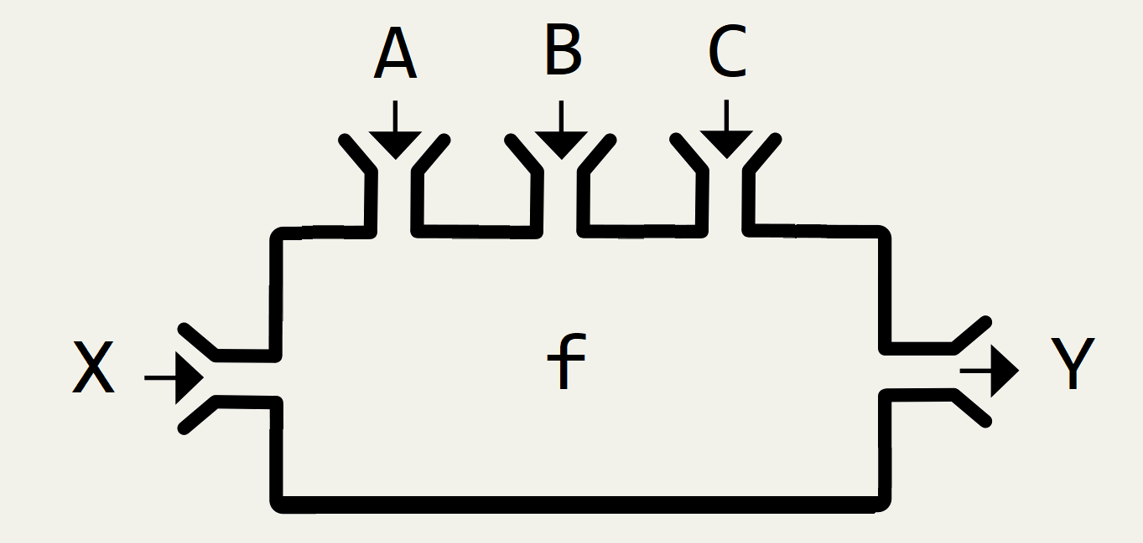

Slide 85
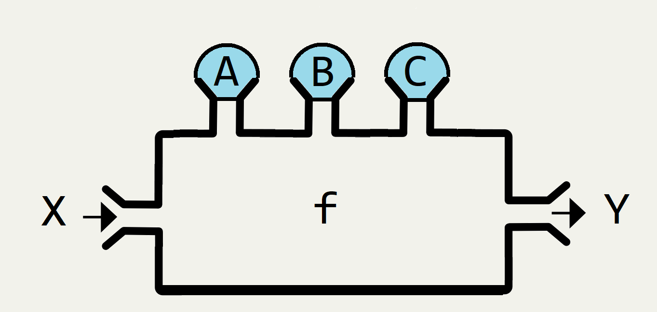

Slide 86
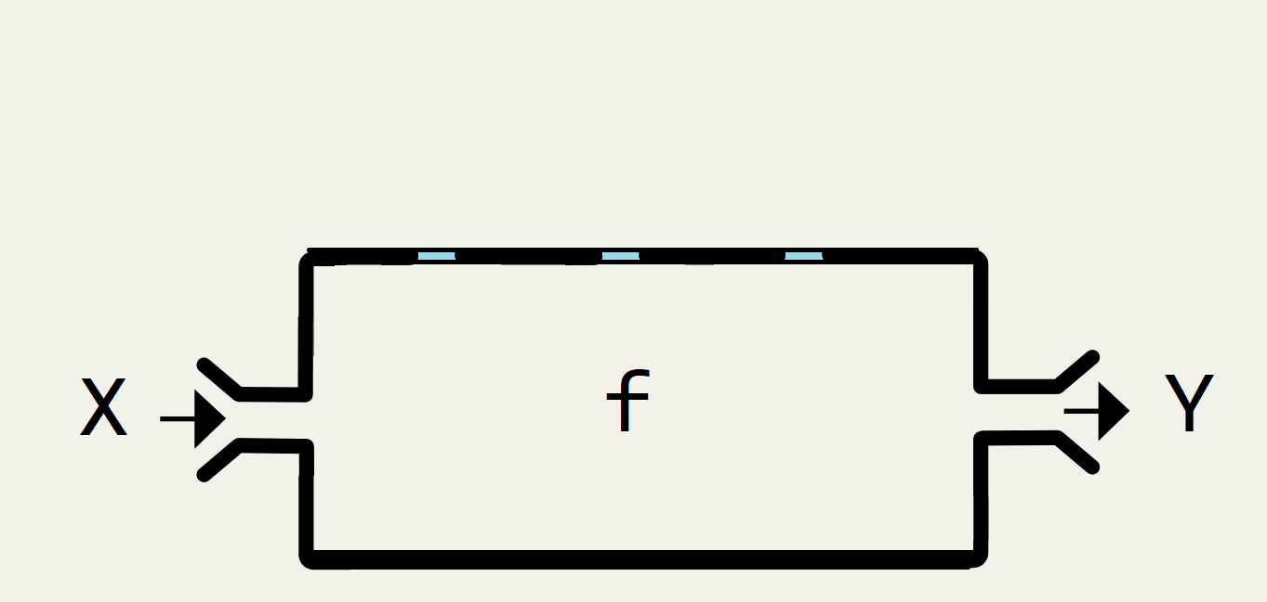

Slide 87
f a b c x = y
f a b c : X -> Y
Assemble almost everything
except the final component

Slide 88
f a b c x = y
g m n o y = z
f a b c : X -> Y
g m n o : Y -> Z

Slide 89
f a b c x = y
g m n o y = z
f a b c : X -> Y
g m n o : Y -> Z
x
|> f a b c
|> g m n o

Slide 90
f a b c x = y
g m n o y = z
f a b c : X -> Y
g m n o : Y -> Z
x
|> f a b c
|> g m n o
Assemble almost everything
except the final component

Slide 91
Example (n - 1)
[1 .. 100]
|> List.filter (fun x -> x % 3 = 0 || x % 5 = 0)
|> List.map (fun x -> x * x)
|> List.sum

Slide 92
Example (n - 1)
[1 .. 100]
|> List.filter (fun x -> x % 3 = 0 || x % 5 = 0)
|> List.map (fun x -> x * x)
|> List.sum
Assemble almost everything
except the final component

Slide 93
C# Extension Method “this”
public static B1 f(this A1 a1, A2 a2, A3 a3){......}
public static C1 g(this B1 b1, B2 b2, B3 b3){......}
public static D1 h(this C1 c1, C2 c2, C3 c3){......}
f: A1,A2,A3 -> B1
g: B1,B2,B3 -> C1
h: C1,C2,C3 -> D1

Slide 94
C# Extension Method “this”
a1
.f(a2,a3)
.g(b2,b3)
.h(c2,c3);
f: A1,A2,A3 -> B1
g: B1,B2,B3 -> C1
h: C1,C2,C3 -> D1

Slide 95
a1
.f(a2,a3)
.g(b2,b3)
.h(c2,c3);
f(a1,a2,a3)
.g(b2,b3)
.h(c2,c3);
h(g(f(a1,a2,a3),b2,b3),c2,c3);
g(f(a1,a2,a3),b2,b3)
.h(c2,c3);
Syntactic sugar

Slide 96
General Case in C#
Func<A,B,C,D,Z> f(a,b,c,d)
f(a) // COMPILE ERROR!
f(a,b) // COMPILE ERROR!
f(a,b,c) // COMPILE ERROR!

Slide 97
“Currying”
Func<A, Func<B,Func<C,Func<D,Z>>>>
Flexible
Func<A,B,C,D,Z>
Not flexible (need to assemble everything)

Slide 98
Func<A, Func<B,Func<C,Func<D,Z>>>>
Func<A, Func<B,Func<C,Func<D,Z>>>>
Func<A, Func<B,Func<C,Func<D,Z>>>>
Func<A, Func<B,Func<C,Func<D,Z>>>>

Slide 99
“Currying”
Func<A, Func<B,Func<C,Func<D,Z>>>> Curry (Func<A,B,C,D,Z> f) {
return a => b => c => d => f(a,b,c,d);
}
var g = Curry(f);
g(a) Compiles!
g(a)(b) Compiles!
g(a)(b)(c) Compiles!

Slide 100
Higher Order Functions
Function as inputs

Slide 101
Primitive Types
public double f(double a, int b, string c){......}
Basic data types as inputs/outputs

Slide 102
Functions as input
public double f(Func<double,int> g, string c){......}
Function “f” accepts another function “g” as input.

Slide 103
Functions as output
public Func<int,double> f(double a, int b, string c){......}
Function “f” returns another function as output.

Slide 104
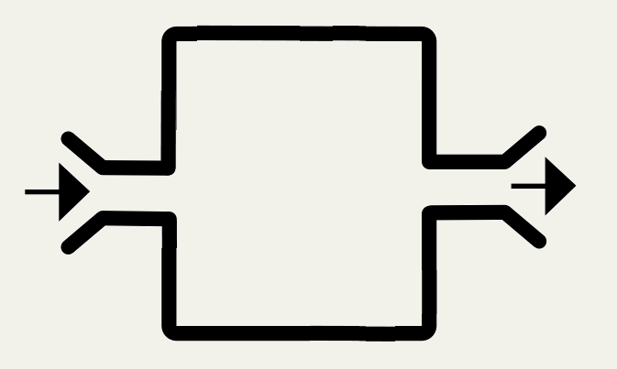



Slide 105
filter, map
[1 .. 999]
|> List.filter (fun x -> x % 3 = 0 || x % 5 = 0)
|> List.sum
[1 .. 100]
|> List.map (fun x -> x * x)
|> List.sum

Slide 106
Filter
let filter f xs = ......
(X -> bool) -> List<X> -> List<X>
List<X> filter(Func<X,bool> f, List<X> xs)
LINQ.Where

Slide 107
Map
let map f xs = ......
(X -> Y) -> List<X> -> List<Y>
List<Y> map(Func<X,Y> f, List<X> xs)
LINQ.Select

Slide 108
Example

Slide 109
Insurance Pricing Example
How much to charge a customer for an insurance product?
let Price = ......

Slide 110
let Price =
......

Slide 111
e.g. Depends on Age.
let Price age =
......
age : int
int -> $$$

Slide 112
e.g. Depends on probability of injury.
let Price age prob =
......
age : int
prob: double
int -> double -> $$$

Slide 113
What if the probability depends on time?
let Price age prob =
......
age : int
prob: ??????
int -> ?????? -> $$$

Slide 114
Pass in a function
let Price age probFunc =
......
age : int
probFunc: DateTime -> double
int -> (DateTime -> double) -> $$$

Slide 115
Example

Slide 116
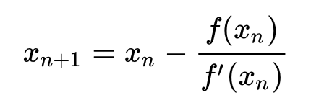
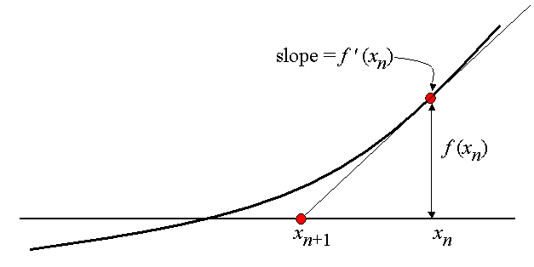
Newton’s Method Example

Slide 117
Newton’s Method Example
float -> Func -> Func -> float
let Newton start f df =
let mutable counter = start
while (......) do
counter <- counter - (f counter) / (df counter)

Slide 118
Summary

Slide 119
Summary of Tricks
Chain/pipe functions as much as possible.
Use partial application for get a new function.
  “this” keyword for special case (n-1)
Higher order functions.
  Use Functions as inputs and outputs.

Slide 120
Future Topics
Sets, Lists, Dictionary
Pattern Matching
Union Type, Tuples, Records
Option Type (Missing/null Values)
Async
Impure Operations

Slide 121
Where to learn?
FSharpforfunandprofit blog
  https://fsharpforfunandprofit.com/
Real-World Functional Programming
  https://www.manning.com/books/real-world-functional-programming

Slide 122
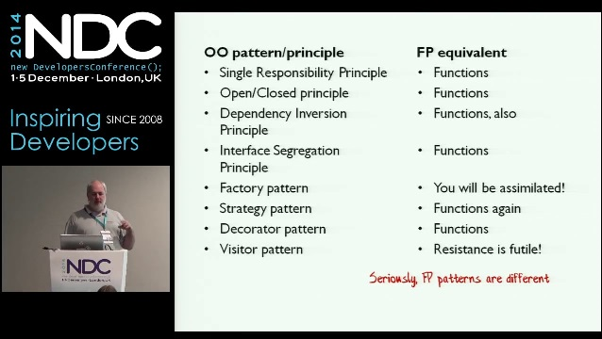
Conference videos?
Scott Wlaschin (author for F#forfunandprofit)
  Great tech educator.
  Given many good talks during NDC Conference. (Available on Youtube)

Slide 123
How to learn?
FSharpForFunAndProfit blog
Try out Project Euler Questions.
I have some training materials for interns.

Slide 124
Sources (Who uses FP)
https://www.janestreet.com/technology/
https://reasonml.github.io/
https://fsharp.org/testimonials/
https://devblogs.nvidia.com/jet-gpu-powered-fulfillment/
https://www.scala-lang.org/old/node/1658
https://clojure.org/community/companies
https://www.slideshare.net/naughty_dog/statebased-scripting-in-uncharted-2-among-thieves

Slide 125
Q&A

